Slide 1
RDD2: Fuzzy
UIUC ECON 474 Econometrics of Policy Evaluation

Slide 2
Overview
Next lecture: Read Ch 6.1, 6.2
Overview
Fuzzy RDD vs. sharp RDD
Angrist and Lavy (1999)
LAB: replicate fuzzy RDD

Slide 3
Fuzzy RDD vs. Sharp RDD
Abrupt changes to treatment status vs. probability of treatment

Slide 4
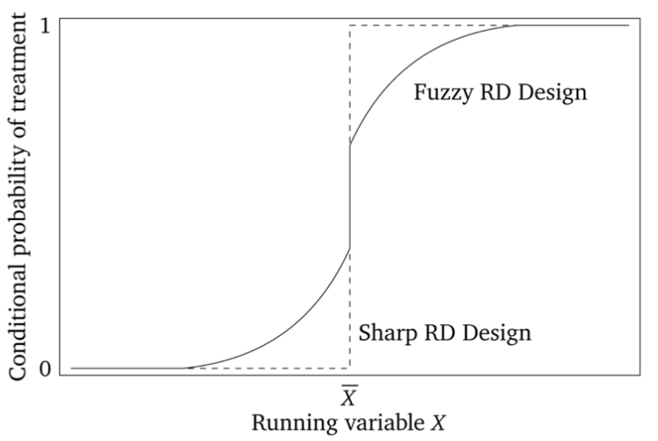
Fuzzy RDD is abrupt change to prob. of treatment

Slide 5
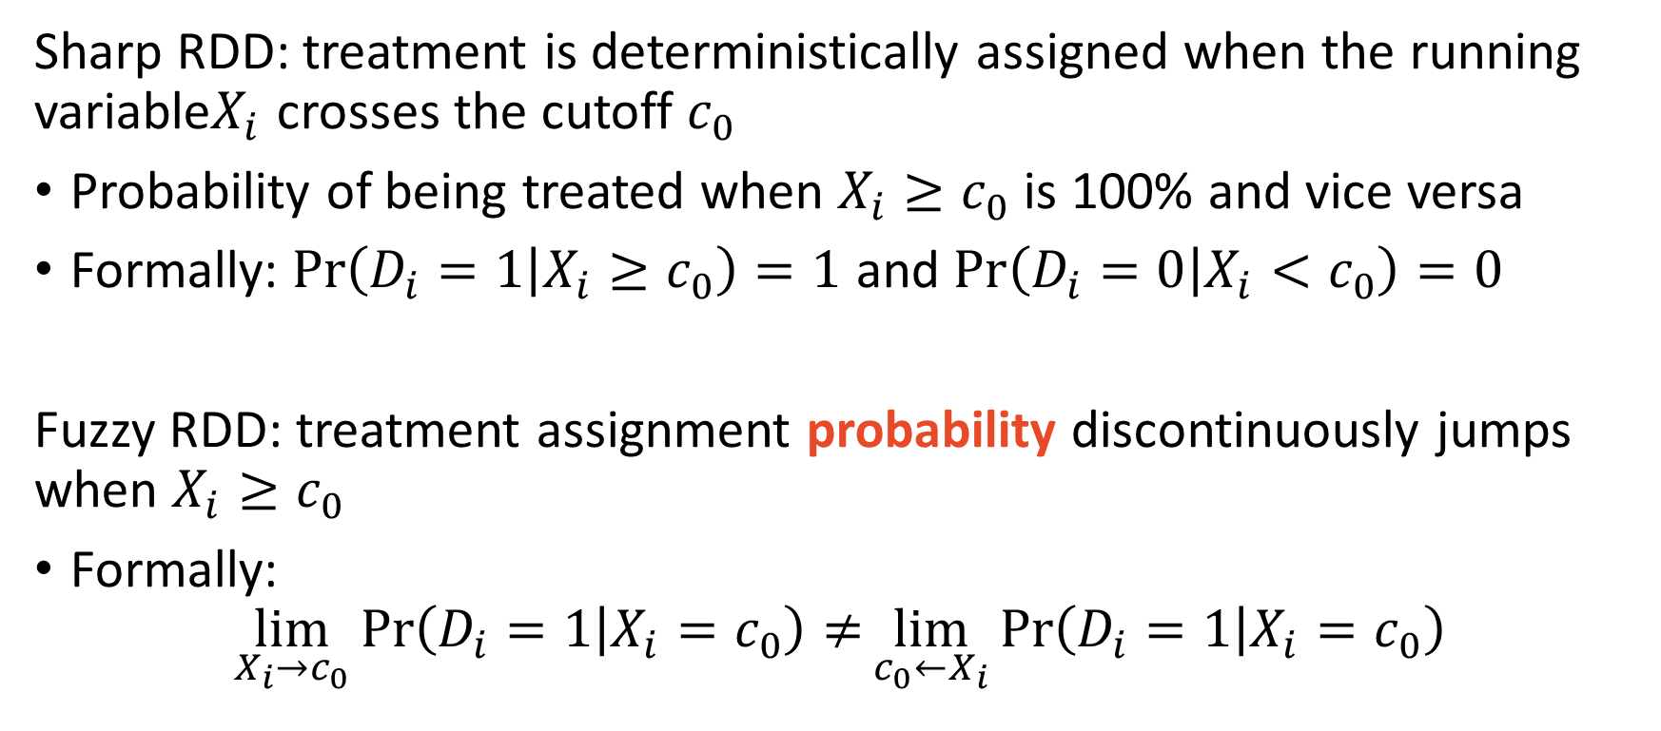
Fuzzy RDD is a discontinuity of treatment probability
Sharp RDD: treatment is deterministically assigned when the running variable$X_{i}$ crosses the cutoff $c_{0}$
Probability of being treated when $X_{i}≥c_{0}$ is 100% and vice versa
Formally: $Pr\left(D_{i}=1 | X_{i}≥c_{0}\right)=1$ and $Pr\left(D_{i}=0 | X_{i}<c_{0}\right)=0$
Fuzzy RDD: treatment assignment probability discontinuously jumps when $X_{i}≥c_{0}$
Formally:
$$\lim_{X_{i}→c_{0}}{\operatorname{Pr}\left(D_{i}=1 | X_{i}=c_{0}\right)≠}\lim_{c_{0}←X_{i}}{\operatorname{Pr}\left(D_{i}=1 | X_{i}=c_{0}\right)}$$

Slide 6
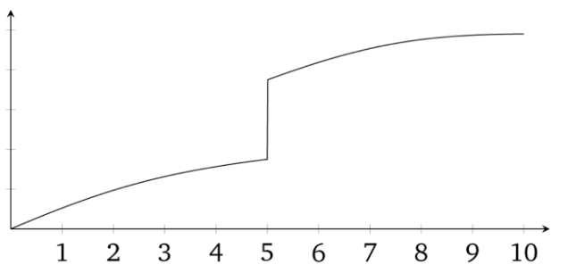
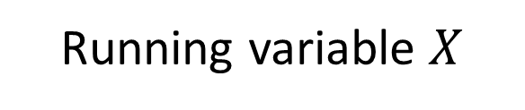
Fuzzy RDD first stage
Treatment Probability
Running variable $X$

Slide 7
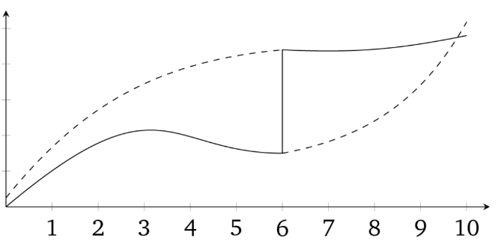


Fuzzy RDD smooth potential outcomes at $c_{0}=6$
$$Y^{1}$$
Treatment Probability
$$Y^{o}$$
Running variable $X$

Slide 8
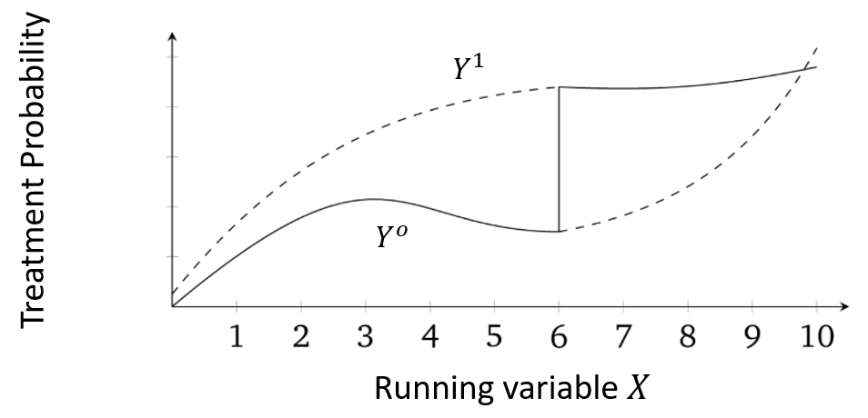
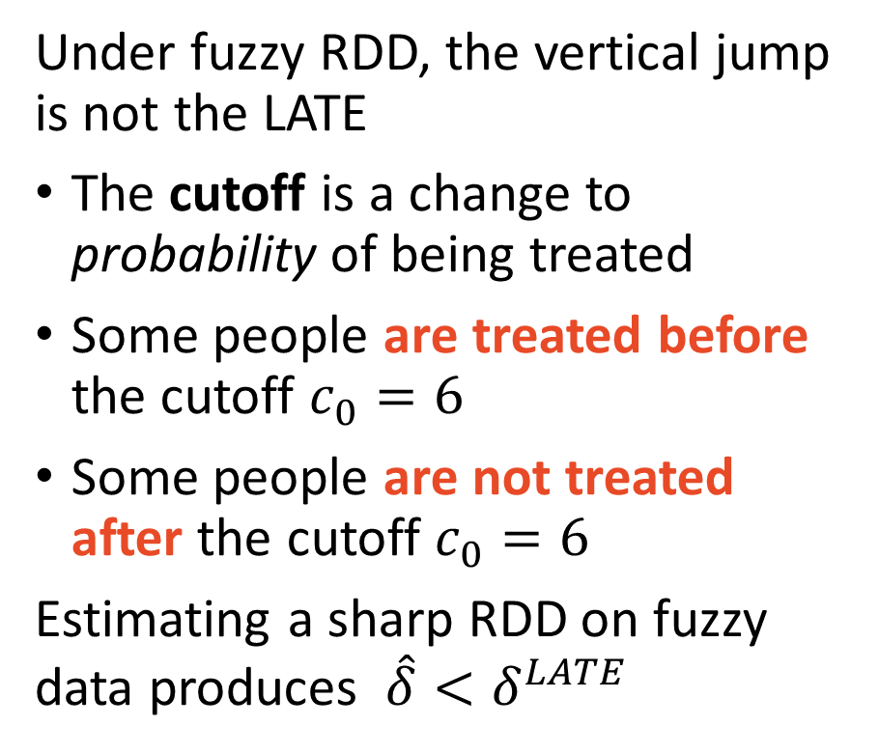
Sharp RDD estimates on fuzzy data are biased
Under fuzzy RDD, the vertical jump is not the LATE
The cutoff is a change to probability of being treated
Some people are treated before the cutoff $c_{0}=6$
Some people are not treated after the cutoff $c_{0}=6$
Estimating a sharp RDD on fuzzy data produces ${\hat{δ}<δ}^{LATE}$

Slide 9



“What is that I hear? A biased estimator?”
2SLS

Slide 10
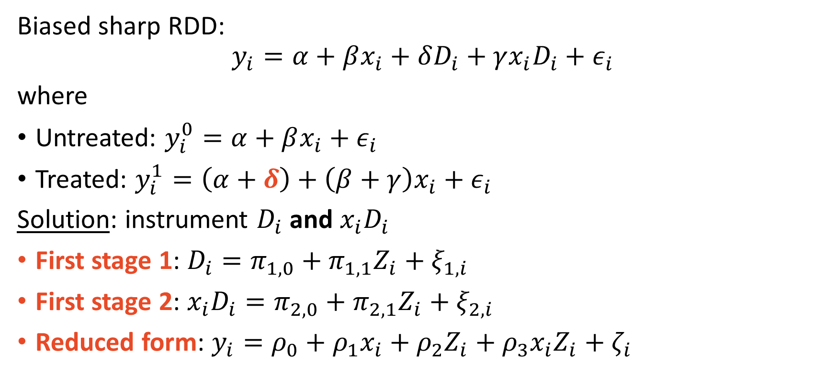
Fuzzy RDD is IV sharp RDD
Biased sharp RDD:
$$y_{i}=α+βx_{i}+δD_{i}+γx_{i}D_{i}+ε_{i}$$
where
Untreated: $y_{i}^{0}=α+βx_{i}+ε_{i}$
Treated: $y_{i}^{1}=\left(α+δ\right)+\left(β+γ\right)x_{i}+ε_{i}$
Solution: instrument $D_{i}$ and $x_{i}D_{i}$
First stage 1: $D_{i}=π_{1,0}+π_{1,1}Z_{i}+ξ_{1,i}$
First stage 2: $x_{i}D_{i}=π_{2,0}+π_{2,1}Z_{i}+ξ_{2,i}$
Reduced form: $y_{i}=ρ_{0}+ρ_{1}x_{i}+ρ_{2}Z_{i}+ρ_{3}x_{i}Z_{i}+ζ_{i}$

Slide 11
Both RDD and IV identifying assumptions apply
RDD:
Continuity assumption
Individuals around cutoff are representative counterfactuals (balance covariates)
Cutoff induces treatment
2SLS:
SUTVA
Independence
Inclusion restriction
Exclusion restriction
Monotonicity

Slide 12
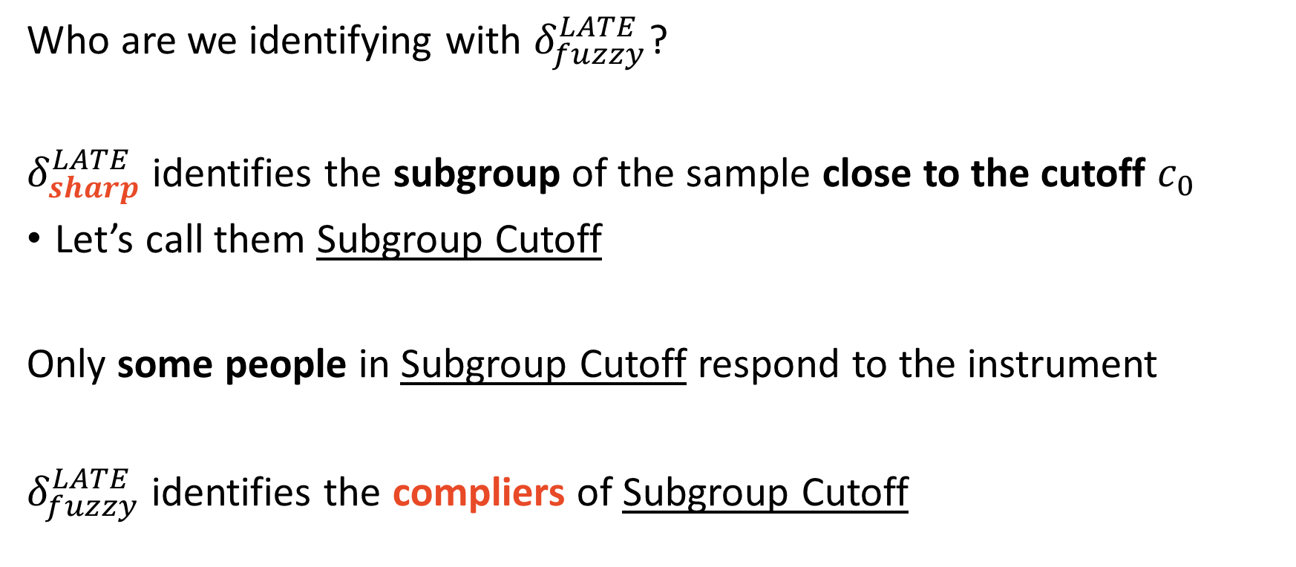
Fuzzy RDD identifies the RDD compliers
Who are we identifying with $δ_{fuzzy}^{LATE}$?
$δ_{sharp}^{LATE}$ identifies the subgroup of the sample close to the cutoff $c_{0}$
Let’s call them Subgroup Cutoff
Only some people in Subgroup Cutoff respond to the instrument
$δ_{fuzzy}^{LATE}$ identifies the compliers of Subgroup Cutoff

Slide 13
Angrist and Lavy (1999) “Using Maimonides Rule to Estimate the Effect of Class Size on Scholastic Achievement”
Do student teacher ratios matter?

Slide 14
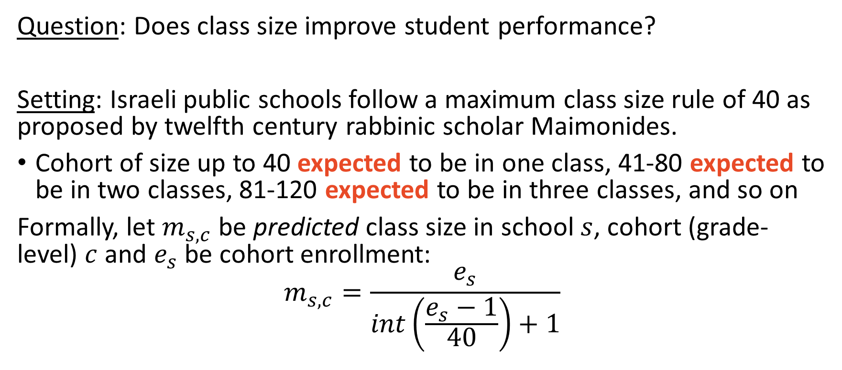
Angrist and Lavy (1999) Overview
Question: Does class size improve student performance?
Setting: Israeli public schools follow a maximum class size rule of 40 as proposed by twelfth century rabbinic scholar Maimonides.
Cohort of size up to 40 expected to be in one class, 41-80 expected to be in two classes, 81-120 expected to be in three classes, and so on
Formally, let $m_{s,c}$ be predicted class size in school $s$, cohort (grade-level) $c$ and $e_{s}$ be cohort enrollment:
$$m_{s,c}=\frac{e_{s}}{int\left(\frac{e_{s}−1}{40}\right)+1}$$

Slide 15
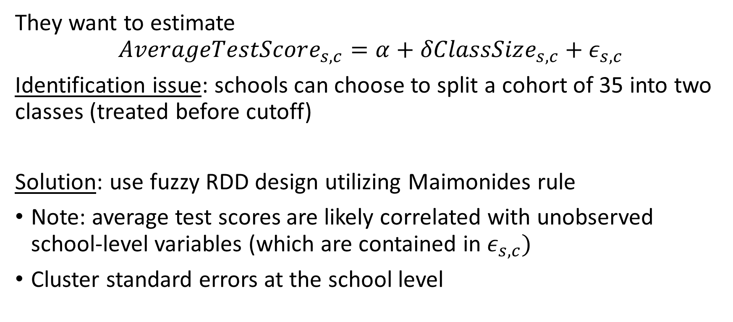
Angrist and Lavy (1999) Overview
They want to estimate
$$AverageTestScore_{s,c}=α+δClassSize_{s,c}+ε_{s,c}$$
Identification issue: schools can choose to split a cohort of 35 into two classes (treated before cutoff)
Solution: use fuzzy RDD design utilizing Maimonides rule
Note: average test scores are likely correlated with unobserved school-level variables (which are contained in $ε_{s,c})$
Cluster standard errors at the school level

